Slide 1
Measuring Output and Inflation
Rajiv Sethi and the CORE Team

Slide 2
Overview
Real and Nominal GDP
Measuring Price Changes
The GDP Deflator
The Consumer Price Index
Reading: The Economy Unit 1.2

Slide 3
Measuring Inflation

Slide 4
Real and Nominal GDP
Nominal GDP: value of goods/services at current prices
Real GDP: value of goods/services at constant prices
Base year determines which prices are used
GDP Deflator: Ratio of Nominal to Real GDP
Inflation Rate: Growth rate of GDP deflator
Note: inflation measure is sensitive to choice of base year
What is the value of the GDP deflator in the base year?

Slide 5
Example
Consider two years, 2018 and 2019
Three goods: cloth, wine, diamonds
2018 outputs: 10,000 cloth, 8,000 wine, 100 diamonds
2018 prices: $10 cloth, $10 wine, $1,000 diamonds
2019 outputs: 10,500 cloth, 7,500 wine, 105 diamonds
2019 prices: $9 cloth, $12 wine, $1,200 diamonds
What is Nominal GDP in each year and its growth rate
What is Real GDP in each year and it’s growth rate?
Does it matter which year we use as base year?

Slide 6
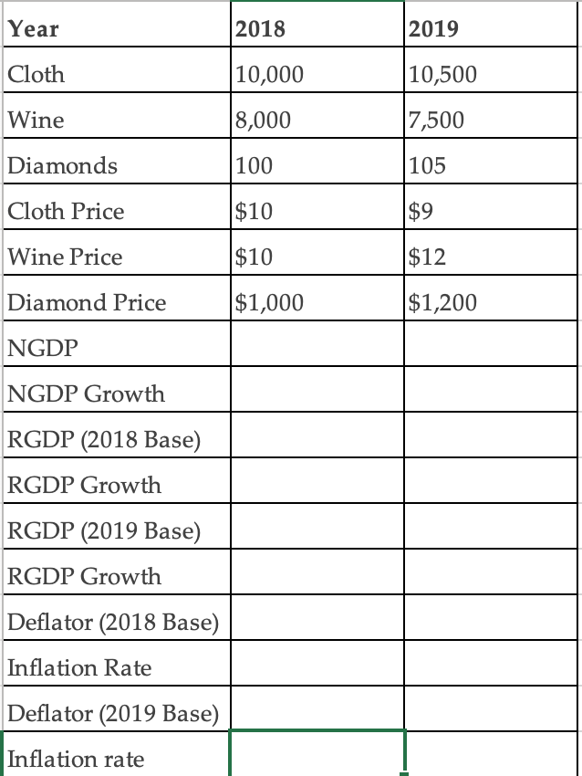

Slide 7
Consumer Price Index
For wage negotiations, overall inflation rate less relevant
Alternative approach: consumer price index
Based on a basket of goods/services
Growth in CPI gives alternative measure of inflation
Suppose basket is: 10 cloth, 5 wine
What is the CPI inflation rate in our example?

Slide 8
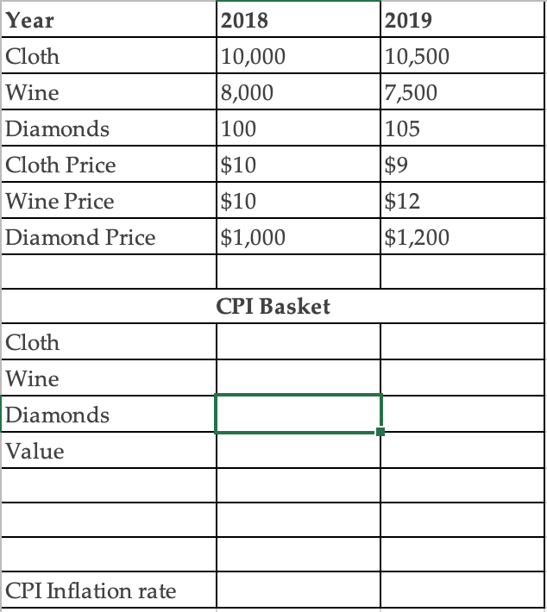

Slide 9
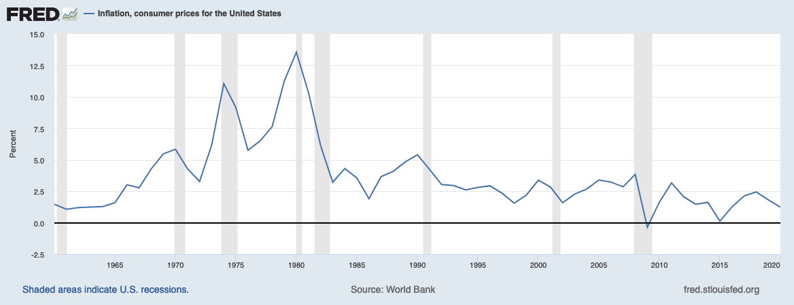
View Latest Data
Notes:
Source: World Bank Release: World Development Indicators Units: Percent, Not Seasonally Adjusted Frequency: Annual Inflation as measured by the consumer price index reflects the annual percentage change in the cost to the average consumer of acquiring a basket of goods and services that may be fixed or changed at specified intervals, such as yearly. The Laspeyres formula is generally used.International Monetary Fund, International Financial Statistics and data files. World Bank, Inflation, consumer prices for the United States [FPCPITOTLZGUSA], retrieved from FRED, Federal Reserve Bank of St. Louis; https://fred.stlouisfed.org/series/FPCPITOTLZGUSA, April 27, 2020.

Slide 10
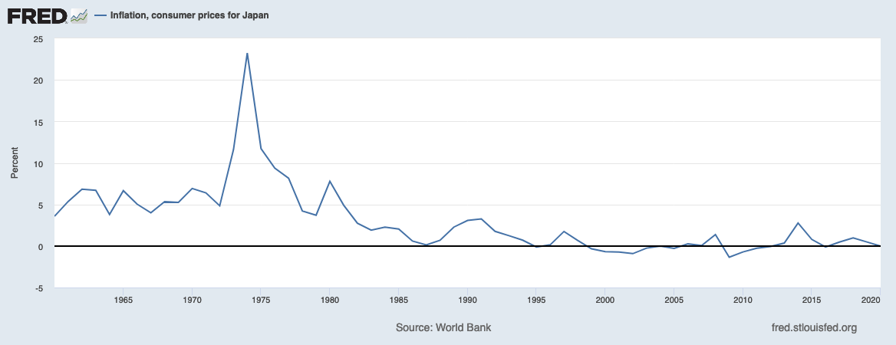
View Latest Data
Notes:
Source: World Bank Release: World Development Indicators Units: Percent, Not Seasonally Adjusted Frequency: Annual Inflation as measured by the consumer price index reflects the annual percentage change in the cost to the average consumer of acquiring a basket of goods and services that may be fixed or changed at specified intervals, such as yearly. The Laspeyres formula is generally used.International Monetary Fund, International Financial Statistics and data files. World Bank, Inflation, consumer prices for the United States [FPCPITOTLZGUSA], retrieved from FRED, Federal Reserve Bank of St. Louis; https://fred.stlouisfed.org/series/FPCPITOTLZGUSA, April 27, 2020.

Slide 11
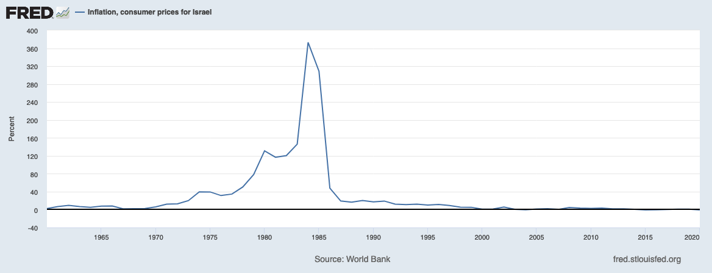
View Latest Data
Notes:
Source: World Bank Release: World Development Indicators Units: Percent, Not Seasonally Adjusted Frequency: Annual Inflation as measured by the consumer price index reflects the annual percentage change in the cost to the average consumer of acquiring a basket of goods and services that may be fixed or changed at specified intervals, such as yearly. The Laspeyres formula is generally used.International Monetary Fund, International Financial Statistics and data files. World Bank, Inflation, consumer prices for the United States [FPCPITOTLZGUSA], retrieved from FRED, Federal Reserve Bank of St. Louis; https://fred.stlouisfed.org/series/FPCPITOTLZGUSA, April 27, 2020.

Slide 12
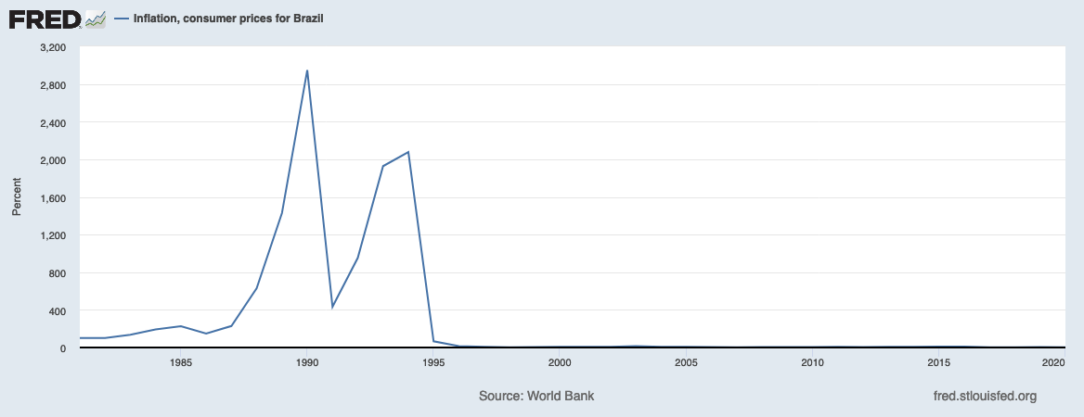
View Latest Data
Notes:
Source: World Bank Release: World Development Indicators Units: Percent, Not Seasonally Adjusted Frequency: Annual Inflation as measured by the consumer price index reflects the annual percentage change in the cost to the average consumer of acquiring a basket of goods and services that may be fixed or changed at specified intervals, such as yearly. The Laspeyres formula is generally used.International Monetary Fund, International Financial Statistics and data files. World Bank, Inflation, consumer prices for the United States [FPCPITOTLZGUSA], retrieved from FRED, Federal Reserve Bank of St. Louis; https://fred.stlouisfed.org/series/FPCPITOTLZGUSA, April 27, 2020.

Slide 13
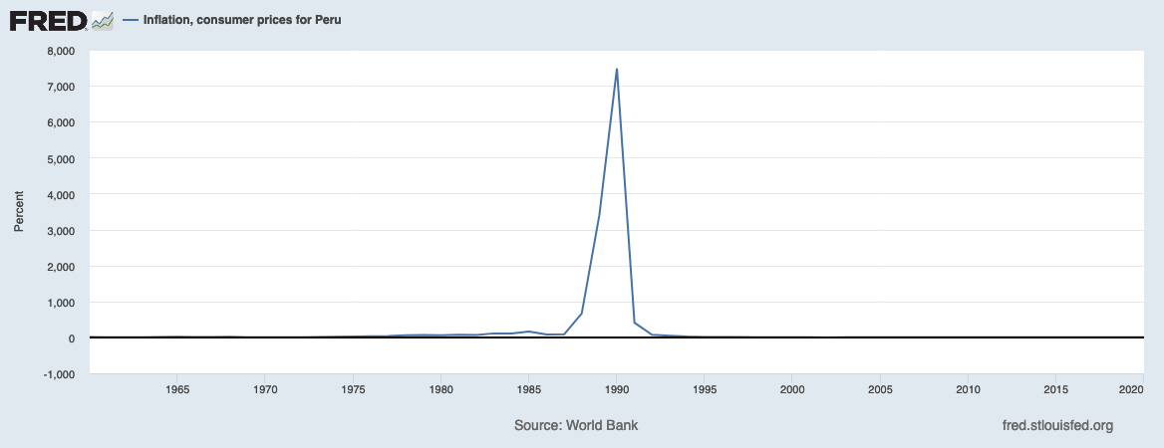
View Latest Data
Notes:
Source: World Bank Release: World Development Indicators Units: Percent, Not Seasonally Adjusted Frequency: Annual Inflation as measured by the consumer price index reflects the annual percentage change in the cost to the average consumer of acquiring a basket of goods and services that may be fixed or changed at specified intervals, such as yearly. The Laspeyres formula is generally used.International Monetary Fund, International Financial Statistics and data files. World Bank, Inflation, consumer prices for the United States [FPCPITOTLZGUSA], retrieved from FRED, Federal Reserve Bank of St. Louis; https://fred.stlouisfed.org/series/FPCPITOTLZGUSA, April 27, 2020.

Slide 14
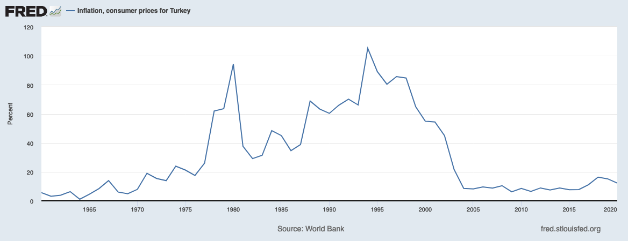
View Latest Data
Notes:
Source: World Bank Release: World Development Indicators Units: Percent, Not Seasonally Adjusted Frequency: Annual Inflation as measured by the consumer price index reflects the annual percentage change in the cost to the average consumer of acquiring a basket of goods and services that may be fixed or changed at specified intervals, such as yearly. The Laspeyres formula is generally used.International Monetary Fund, International Financial Statistics and data files. World Bank, Inflation, consumer prices for the United States [FPCPITOTLZGUSA], retrieved from FRED, Federal Reserve Bank of St. Louis; https://fred.stlouisfed.org/series/FPCPITOTLZGUSA, April 27, 2020.

Slide 15
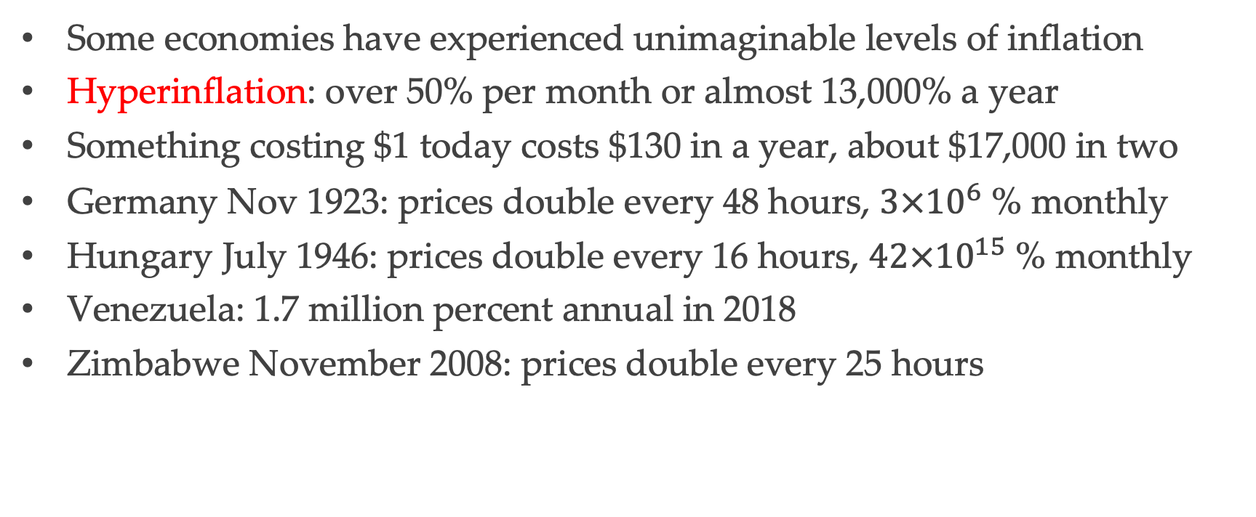
Hyperinflation
Some economies have experienced unimaginable levels of inflation
Hyperinflation: over 50% per month or almost 13,000% a year
Something costing $1 today costs $130 in a year, about $17,000 in two
Germany Nov 1923: prices double every 48 hours, $3×{10}^{6}$ % monthly
Hungary July 1946: prices double every 16 hours, $42×{10}^{15}$ % monthly
Venezuela: 1.7 million percent annual in 2018
Zimbabwe November 2008: prices double every 25 hours

Slide 16
Cost of Inflation
Many contracts denominated in nominal terms
Example: mortgages and other debt contracts
Also wages, salaries, rental agreements, other long term contracts
Costs of inflation depend on whether or not it is anticipated
Unanticipated inflation transfers resources from creditors to debtors
Unanticipated deflation has the opposite effect
Raises the real value of debt, can lead to insolvency

